Slide 1
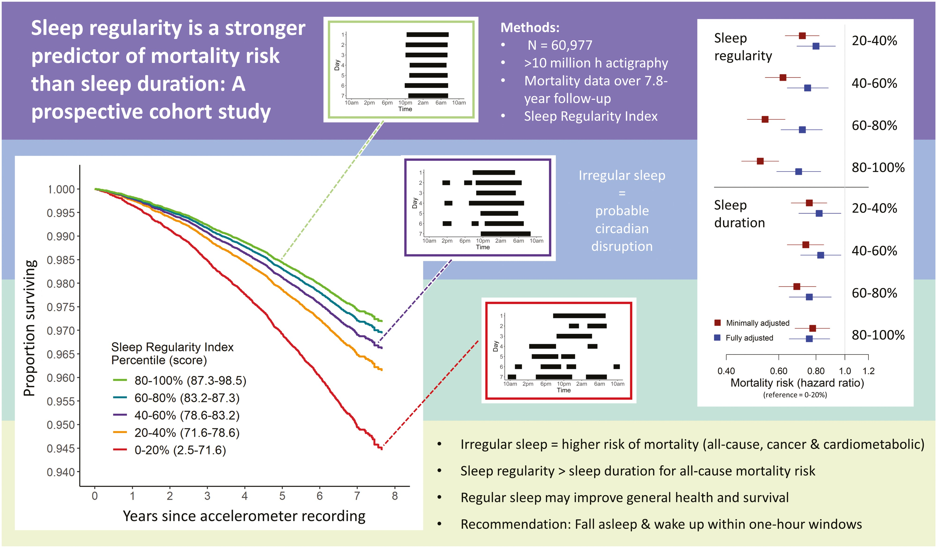

Graphical Abstract
Notes:
Graphical Abstract
Unless provided in the caption above, the following copyright applies to the content of this slide: © The Author(s) 2023. Published by Oxford University Press on behalf of Sleep Research Society.This is an Open Access article distributed under the terms of the Creative Commons Attribution License (https://creativecommons.org/licenses/by/4.0/), which permits unrestricted reuse, distribution, and reproduction in any medium, provided the original work is properly cited.

